Slide 1



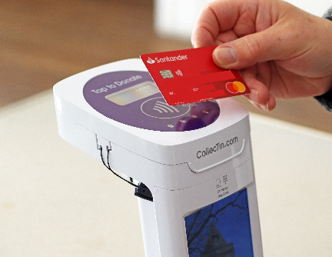




PCC Workshop
Programme
Planning for Growth
Revd Katie de Bourcier
Diocesan Mission Enabler

Slide 2
PCC Workshops
Slides will be sent out to participants after the meeting
This meeting will be recorded with the intention of using it as a resource. Please feel free to turn your camera off if you prefer
Please make sure you are on mute unless speaking
Please put any questions/comments in the chat
During discussions, please use the hands up facility at the bottom of the screen if you wish to contribute
This is part of our support package for parish volunteers and clergy.
Further topics will be advertised in E-News, on Insight and the Treasurer Forum

Slide 3
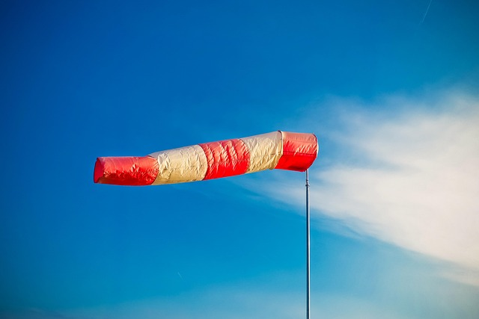
Is God a Planner?
Notes:
Some of us prefer Spirit-led spontaneity; some of us relate to God as one who works through having a plan – there could be some interesting reflection there on how our theological viewpoint relates to our personality preferences!!
The last thing we want to advocate is planning as a human process with no divine activity involved.
I firmly believe that the Holy Spirit can work through our discussions, planning, review and adaptation.
God is a God of surprises, and the wind of the Spirit blows where it will, and life has unexpected twists and turns. Plans will probably have to change, and that’s okay. We will experiment, and some things will work and some won’t, and we’ll learn as we go, and that’s okay.
But there are two things I would emphasise: being attentive, and being intentional. Planning for Growth is about being those things in community in our benefices and deaneries.

Slide 4
Where are we now?
Diocesan total: 68% of benefices have a Plan for Growth in place
Research shows that “churches that intend to grow, tend to grow”.
Attentive, and intentional
Notes:
We track Plans for Growth by benefice across the diocese, and these figures show where we have PfGs in place from 2022 or later. That’s a really good overall percentage – but it still leaves 35% without, and we’d love to reduce that.
Research shows that churches that intend to grow, tend to grow. That doesn’t mean that having a Plan for Growth automatically leads to that growth, but it is about mindset, intentionality, and focus.
And yes, when I say growth, I mean all four dimensions of our Growing in God strategy: depth, influence, number and younger. We are talking about holistic growth, not just numerical growth.

Slide 5
Why change?
Deanery plans: A cumbersome, data-heavy template dating back to 2018, plus a variety of simpler and clearer approaches in some deaneries.
Benefice plans: A template that asks about the listening done in developing the Plan, the priorities set, and the actions to be taken to make disciples, grow disciples, and serve the community
Aims:
to reflect on and learn from experience
to align deanery and benefice planning processes
to continue to embed a missional culture within the diocese
Notes:
Change underpinned by two things: a complex deanery planning template vs a deliberately very simple benefice template, with the two processes not connected – so a need to update and align; and the good practice of reviewing current practice as part of our wider moves to develop the missional culture of the diocese, and see what we might need to learn, and how we can improve. Not change for change’s sake!

Slide 6
What is changing?
Templates for deaneries and benefices that match each other, so that it is easier to build up the deanery-level picture
Refreshed resources and guidance on the diocesan website, Insight, and by hard copy where needed
Offer of provision of data to deaneries and benefices as they develop or update their plans
Improved diocesan staff follow-up, where specific support is requested, and at the 18 month and three year points
Meetings between Archdeacon, RD and LC to support the development and implementation of each deanery’s plan
Notes:
Based on reviewing experience of the existing system, the survey of RDs and LCs, and looking at examples of practice in other dioceses, the Strategic Programme Board has agreed a way forward.
It keeps the templates simple, but benefices and deaneries are very welcome to add additional detail if they wish, as some do. The way the questions are framed has changed, however, to encourage more than one-sentence responses.
It has more emphasis on recognising what God and the local church are already doing, rather than assuming a blank sheet of paper. It also invites a little more information on implementation and review, to move the benefice plans on from statements of intent, towards something more action-focused.
The deanery and benefice templates reflect each other very closely. Over time, that should help with the read across between the two – benefice plans feeding up into deanery plans, deanery plans offering guidance to benefices.
Much data is already available via the Parish Dashboards; we are improving our data analysis tools in the diocesan office, especially by introducing Power BI, and aim to be able to provide more information and insights in future. In the meantime, we can provide on request data for benefices such as Stats for Mission trends over time if that would be helpful.

Slide 7
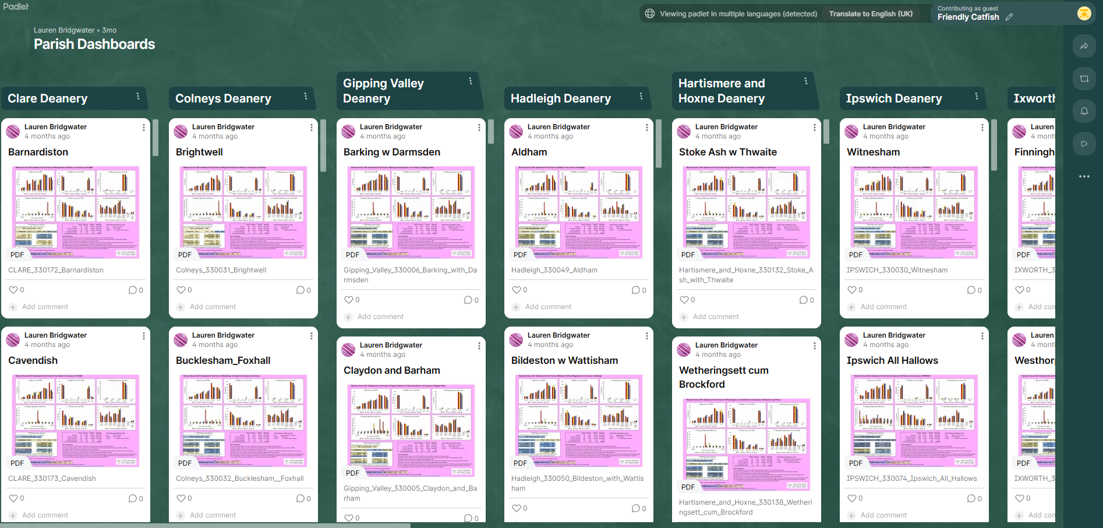
Notes:
Parish Dashboards padlet – will circulate link.

Slide 8
What are we asking you do do?
Rural Deans and Lay Chairs: to cascade information and promote Planning for Growth
Deaneries: Where deanery plans are more than three years old, to review and update them, using the new template. Where there is no plan, to develop one.
Benefices: Where benefices Plans for Growth are more than three years old, to review and update them, using the new template. Where there is no plan, to develop one. Where a plan exists but we haven’t seen it, to send it to us with the new template as a summary.
Notes:
There are many ways to approach planning: listening events, awaydays, involving different groups in different ways, taking time or moving swiftly.
The RD and LC, and in a benefice the incumbent, need to be actively engaged. But if someone else has the key skills necessary to lead the process, then great – involve them, or a small team.
Planning can be done aided by one of our training resources, such as Leading your Church into Growth, which gives a framework for prayerful planning, and works for multi-parish settings as well as single church settings.
The wording used can suit the local context – vision or strategy or church development plan, or Plan for Growth. The ways in which it is communicated and kept alive in a benefice or deanery will undoubtedly vary.
Plans can vary in levels of detail and complexity. The actions identified may seem ambitious, or may seem smaller and incremental.

Slide 9
Notes:
My PPL story…need to know which direction the wind is blowing before we take off… etc.
When we talk about listening in the context of Plans for Growth, we are talking about a process rooted in prayer, listening to each other, to our communities, to God.
When we talk about bottom-up, contextual planning, we do that because our approach to mission is rooted in the Missio Dei, the belief that God has a mission in the world, is at work in our communities, and it is those in those communities who are best placed to discern that and to hear where he is leading the local church.
When we talk about priorities, we do that believing that God has resourced us for what he is calling us to do in this season, and that part of knowing those priorities is looking at what he has given us, what we can do with what is in our hands.
When we talk about implementation and action, we know that can only be with the help and equipping of the Holy Spirit.
But to go back to two of my favourite words: planning is about being attentive, and intentional. And it is about being those things in community in our benefices and deaneries. And I think that is a useful thing, and a Godly thing.

