Slide 1
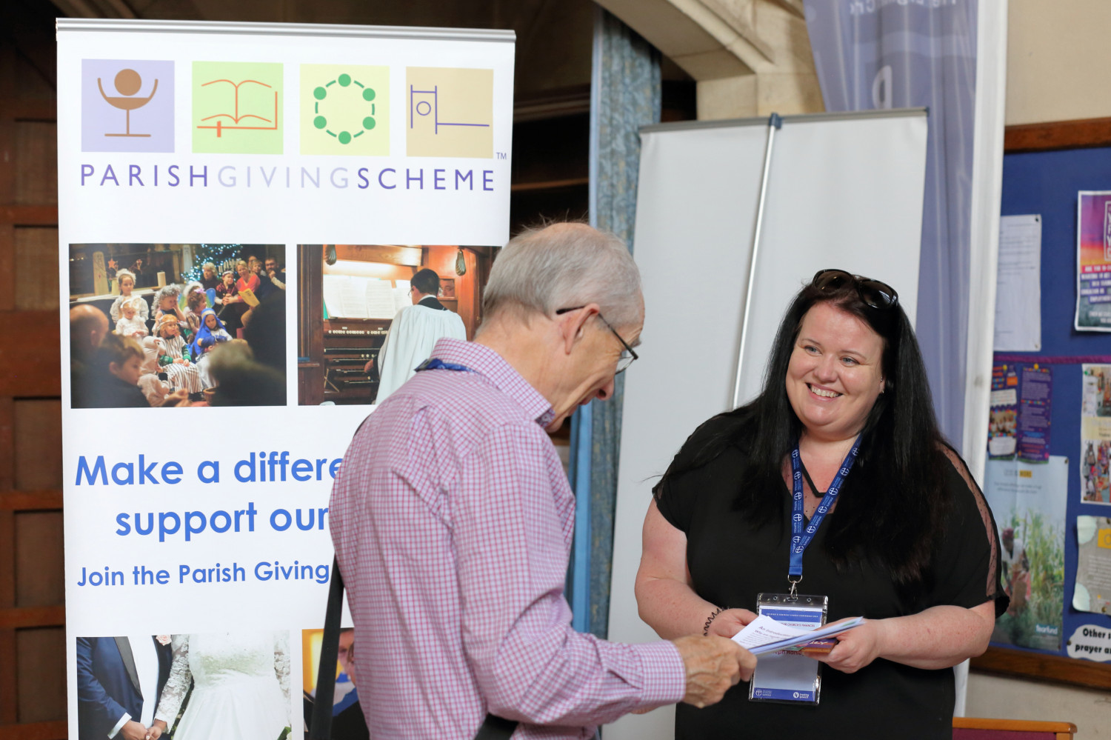

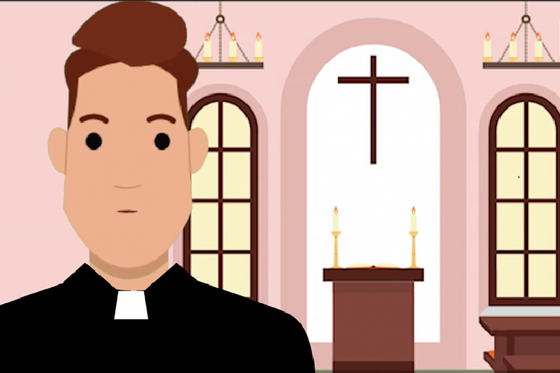
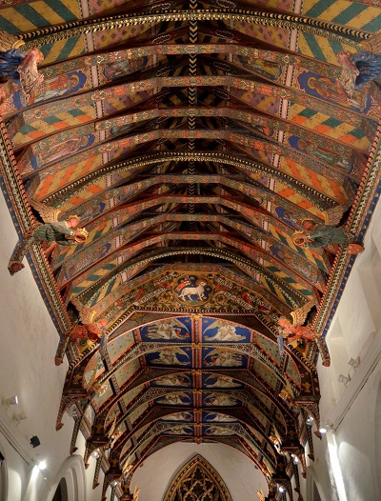

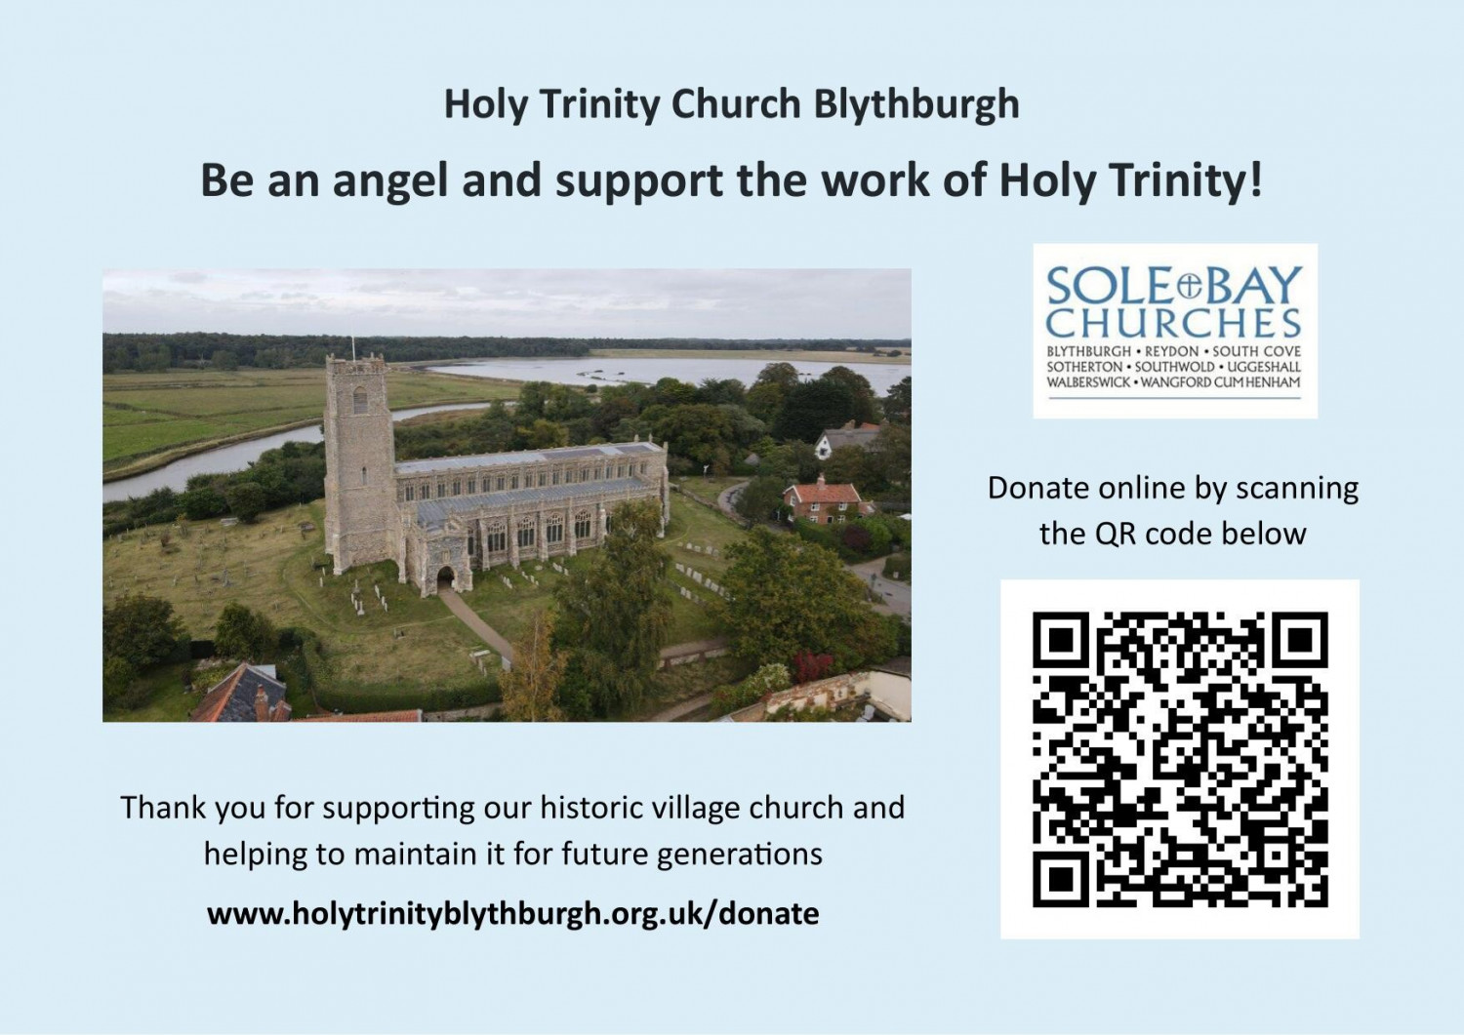
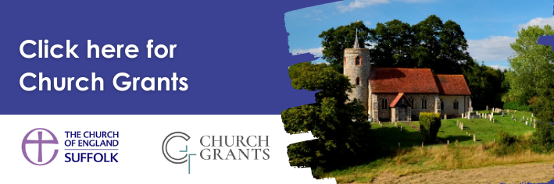
PCC Workshop
Programme
Ask the Registrar: Property Issues
James Hall, Registrar
Kevin Wilson, Deputy Registrar

Slide 2
PCC Workshop Programme
This is part of our PCC Workshop programme offering support and training to our parish volunteers and clergy
You can book for other sessions through Insight https://insight.cofesuffolk.org/?s=PCC+workshop
Current topics available are: Church Boundary Disputes, why the faculty judisdiction matters, and uses of churches & churchyards for commercial purposes; Maintenance work & the importance of engaging appropriate contractors.
Further topics will be advertised in E-News and on Insight.

Slide 3
PCC Workshop:
Slides will be sent out to participants after the meeting
This meeting will be recorded with the intention of editing it and using it as a resource. Please feel free to turn your camera off if you prefer
Please make sure you are on mute unless speaking
Please put any questions/comments in the chat
During discussions please use the hands up facility at the bottom of the screen if you wish to contribute
Welcome to James Hall and Kevin Wilson

Slide 4
Introductions
Legal officers of the Diocese:​
  Diocesan Registrar: James Hall; Deputy: Kevin Wilson
  Diocesan Chancellor: Justin Gau, Deputy: Naomi Gyane
​Registry maintained by Birketts LLP​
Full service, top 50, law firm: Ecclesiastical + Property, Employment, Charity, Private Client, Data Protection etc.​
Work of the Registry​
Advice to PCCs, churchwardens and incumbents​ - the retainer
Advance notice if outside the retainer​
All questions welcome​
https://birketts-ecclesiastical.co.uk/ ​

Slide 5
1. Churchyards and Boundary Disputes
Who is the legal owner of the churchyard?
Burials
Churchyard Regulations
Closed churchyards
Transfer of maintenance obligations to local authority
Boundary disputes

Slide 6
2. Faculty Jurisdiction
What is the Faculty Jurisdiction?
What does it cover?
Why is it important?
Do I need a faculty for everything? Can I just get the AD to approve it?
Is there any assistance?
What’s the Online Faculty System?
What happens if we do something anyway without a faculty?

Slide 7
3. Commercial uses of Churches, Churchyards and Church Halls
Who owns what?
If the DBF owns the church hall, do they get the fees?
Creches, nursery schools and playgroups
Other churches
Plays, concerts, exhibitions
Filming
Other secular groups, eg. Yoga
Hall hire policy

Slide 8
Any questions?

Slide 9
Contact Details
James Hall, Diocesan Registrar​
james-hall@birketts.co.uk​
01473 406270
​
Angie Long, Registry Clerk​
angie-long@birketts.co.uk​
01473 406300
Kevin Wilson, Deputy Registrar​
kevin-wilson@birketts.co.uk​
020 3941 2070
​
Birketts LLP​
Providence House,
141-145 Princes Street,
Ipswich IP1 1QJ

